Slide 1
Opening Slide

Slide 2
Proven Integration Strategies for Government
Larry Singer, Vice President, US State and Local Government and Education Sales
Notes:
Good Morning/Afternoon:
It is my pleasure to have the opportunity to speak with you today about the HP IT Transformation Story.
At HP we have “Turned IT business side up” to become seamlessly aligned with the business.
IT no longer is seen as simply running the business, but rather IT powers the business.

Slide 3

The IT Challenge
32 Million
2007 worldwide IT labor force
65%
of IT budgets to operations
Not enough investment in innovation ;
too much in maintaining legacy infrastructure
Change is constant
Notes:
Despite talk about IT cost cutting, IT spending over the last 15 years has in fact continued to grow.
IT spending significantly outpaced spending in the world economies (based upon cumulative percent increase).
Dip in 2000 mostly due to spend changes in the U.S. economy but spending continues to increase due to growth countries like India and China.
IT spending is back above the highest point it has been in the last decade and a half.
Additionally,
The world IT labor market with respect to IT workers is growing and the US labor market for IT workers is not shrinking. There are more IT workers in the marketplace today than ever before.
IT labor expenditures as a proportion of total IT world spending is increasing.
IT capital expenditures as a proportion of IT total world spending is increasing.
More of the dollars are going toward labor, less of the dollars for technology and more of those dollars are supporting old technology.
Businesses continue to hire people to support legacy systems versus investing in new technologies that would automate support functions.
Freeing up resources from support activities would allow a significant increase in the number of resources available for IT innovation.

Slide 4
Change is the only constant
Change is constant
Everyday events that send ripples throughout the organization, and the IT that supports it
Change is unexpected
A new administration, a news headline, a sudden shift in citizen opinion, a new contract
Change is disruptive
The goal is to minimize the impact of disruptions with an IT environment that is synchronized with the gov’t goals and mission
Change presents opportunities
The ability to adapt to change is a key advantage in gov’t
To survive government must adapt
Notes:
How quickly can your business identify and respond to change? Can you leverage change and turn it to your advantage? Becoming an Adaptive Enterprise can help you improve your responses to both questions. In an Adaptive Enterprise, business and IT capitalize on change. Rather than acting as an obstacle to change, IT becomes a business enabler to:
Maximize return: Improve business results. Grow revenue and earnings. Increase cash flow. Reduce the cost of operations—short and long term.
Customer example: AOL, wholly owned subsidiary of Time Warner, announced that America Online selected HP to be its provider of integrated support services for the company’s server and storage technology. AOL selected HP in order to provide streamline service delivery, cost savings and achieve simplification of its IT environment.
Mitigate risk: Ensure the security and continuity of internal and external business operations. Minimize exposure to external risk factors—such as security threats and availability issues. Ensure compliance to regulatory requirements. Recover automatically from virtually any failure—instantly.
Customer example: Greater Toronto Airports Authority, Secure and scalable wireless LAN to support mission critical applications. Support mission critical applications such as Baggage Reconciliation System, Baggage Tracking System, Common Use Self Service System for more than 70,000 people onsite, 60 airlines, 26 million passengers annually.
Improve performance: Optimize business operations performance across the enterprise from end to end. Gain a holistic real-time view of your enterprise and all the business services enabling your operations—and use that view to monitor service levels, avoid risks, and capitalize on opportunities.
Customer example: Starwood Hotels, one of the leading hotel and leisure companies in the world with more than 750 properties in 80 countries and 110,000 employees, selected HP for $100 million services and technology contract. Starwood expects to save $15 million to $20 million annually on its technology operating costs. Starwood is completely redesigning, deploying, managing and supporting a new hotel reservation system. Starwood will provide improved guest reservation experience worldwide enabling the company to increase occupancy rates, enhance customer loyalty program, significantly reduce operational expenses.
Increase agility: Enable your business organization and operations to adapt to changing business needs and capitalize on emerging opportunities. Provide timely IT support for business innovation. An effective enterprise architecture with business process models reduces costs and makes it easier to address new business priorities, and integrate new technologies.
Customer example: Bank of Baroda, India’s leading international bank, selected HP as its strategic partner for its Technology Enabled Business Transformation project. Upon completion, 25 million customers will have access to banking and financial services. A uniform, portal based infrastructure will enable the bank to realign the way in which it operates with its external and internal customers and business partners.

Slide 5
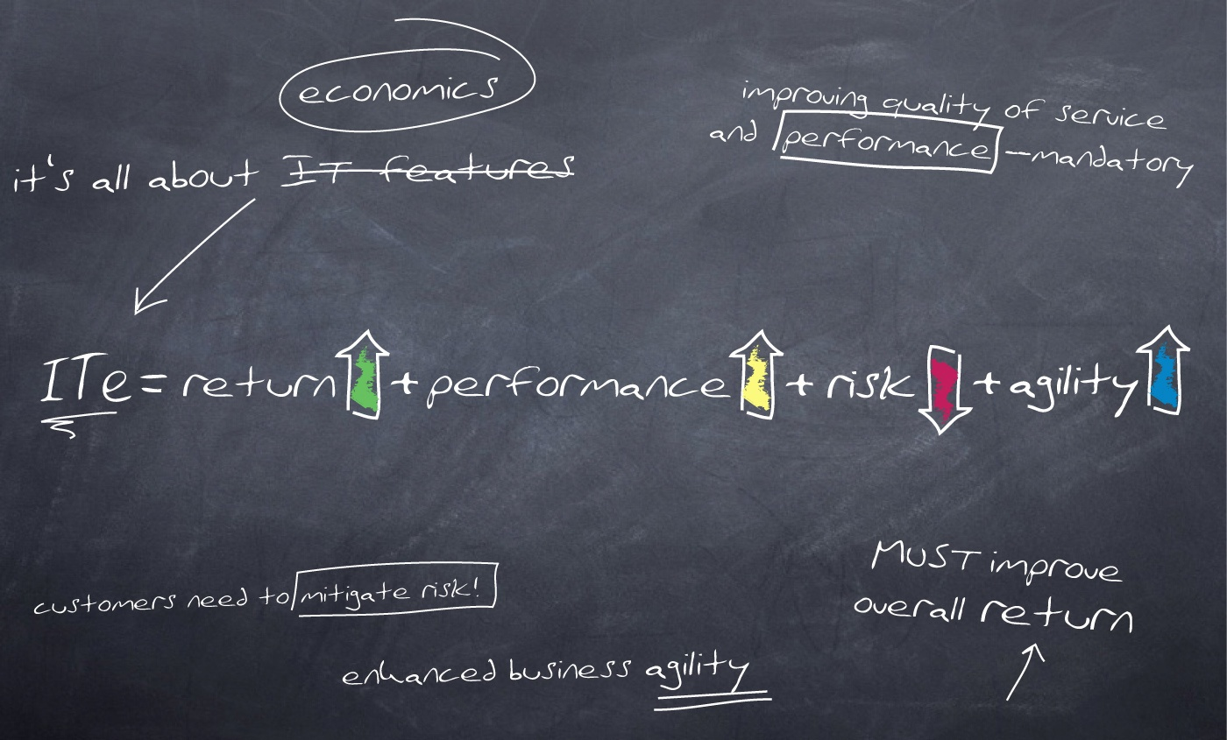
Focus on IT Economics
Notes:
At HP, we and our partners work with your team to become an Adaptive Enterprise. As both a strategic partner and an advisor, we bring experience, a portfolio of standardized, modular technologies and services, and clear architectural guidelines that help you move forward in evolutionary phases. Throughout the process, we share information, insights, and best practices.
Working with HP to become an Adaptive Enterprise enables you to address core business needs— maximize returns, mitigate risk, improve business performance, and increase agility—while continuing to meet today’s business challenges. By creating an environment in which business and IT are synchronized, we help you to create an enterprise that can take change in stride, seize new opportunities, and capitalize upon rapidly changing market conditions—all of which puts you in a powerful position to deliver value, compete, and win in a rapidly changing world.
At the heart of an Adaptive Enterprise is the understanding that business and IT must be synchronized —that is, they must become aligned and stay aligned—for the enterprise to capitalize on change. A business decision— for a new product or service, for a rapid introduction of new products, adoption of a new product or service or any other decision—triggers a series of IT changes. Consider:
A brokerage house needs to be able to update and change its systems to comply with updates and changes in government regulations. For IT, this creates the need to:
Update systems quickly to address short-term reporting requirements
Undertake a longer-term effort in parallel to define a comprehensive, flexible architecture for auditing information systems and operations
An entertainment company must distribute movies across new devices and networks. For IT, this need translates to projects like:
Develop a new media lab
Develop a rights management system for protecting copyrighted property
Develop better online collaboration mechanisms with technology and distribution channel partners
Develop new online support for end-user self-help
A retailer requires real-time supply chain insights to solve emerging inventory problems. IT requirements that must be addressed quickly include:
Identify critical supply-chain key performance indicators (KPIs)
Develop and deploy Web-services–based transactions and workflows to propagate the KPI data across the parties in the supply chain
Implement RFID to strengthen asset tracking, inventory management, and forecasting
Today, every strategic business decision triggers a chain of IT events. The challenge is to ensure that those IT events occur as quickly as the business decision makers need them to occur—and that is where most organizations fall short. The IT organization must translate the new priorities into updated systems and processes, sometimes across multiple layers and organizations. Too often, the IT infrastructure is inflexible, this entails complex, costly, and lengthy change initiatives.
The ideal is to restructure the systems to allow rapid reconfiguration in response to unforeseen needs. Accomplishing that requires strong IT governance and a comprehensive, well-integrated enterprise architecture.

Slide 6
Adaptive Enterprise Defined
Adaptive Enterprise architecture effectively supports the business of government, enables information sharing across traditional barriers, enhances government’s ability to deliver effective and timely services, and supports agencies in their efforts to improve government functions and services.
National Assoc. of State CIOs (NASCIO)
Enterprise Architecture Dev’t Tool-Kit
Notes:
Becoming an Adaptive Enterprise brings extraordinary benefits to enterprises:
Simplicity: When business and IT are synchronized, it’s easier to implement change. Resources work together more efficiently. IT complexity is reduced.
Agility: Enterprises can embrace change to create competitive advantage and adapt in real time to business need
Value: Organizations can free up resources for innovation truly unlocking the value of assets and ultimately enabling growth and profitability.

Slide 7
Today’s “business of government” challenges require IT to adapt
The big shifts
All processes and content will be transformed from physical and static to digital, mobile and virtual
The demand for simplicity, manageability and adaptability will change how citizens work and interface with government
Government ROI justification for IT projects is the norm on almost all levels
Legislation and Mandates sometimes drive IT requirements
Notes:
How quickly can your business identify and respond to change? Can you leverage change and turn it to your advantage? Becoming an Adaptive Enterprise can help you improve your responses to both questions. In an Adaptive Enterprise, business and IT capitalize on change. Rather than acting as an obstacle to change, IT becomes a business enabler to:
Maximize return: Improve business results. Grow revenue and earnings. Increase cash flow. Reduce the cost of operations—short and long term.
Customer example: AOL, wholly owned subsidiary of Time Warner, announced that America Online selected HP to be its provider of integrated support services for the company’s server and storage technology. AOL selected HP in order to provide streamline service delivery, cost savings and achieve simplification of its IT environment.
Mitigate risk: Ensure the security and continuity of internal and external business operations. Minimize exposure to external risk factors—such as security threats and availability issues. Ensure compliance to regulatory requirements. Recover automatically from virtually any failure—instantly.
Customer example: Greater Toronto Airports Authority, Secure and scalable wireless LAN to support mission critical applications. Support mission critical applications such as Baggage Reconciliation System, Baggage Tracking System, Common Use Self Service System for more than 70,000 people onsite, 60 airlines, 26 million passengers annually.
Improve performance: Optimize business operations performance across the enterprise from end to end. Gain a holistic real-time view of your enterprise and all the business services enabling your operations—and use that view to monitor service levels, avoid risks, and capitalize on opportunities.
Customer example: Starwood Hotels, one of the leading hotel and leisure companies in the world with more than 750 properties in 80 countries and 110,000 employees, selected HP for $100 million services and technology contract. Starwood expects to save $15 million to $20 million annually on its technology operating costs. Starwood is completely redesigning, deploying, managing and supporting a new hotel reservation system. Starwood will provide improved guest reservation experience worldwide enabling the company to increase occupancy rates, enhance customer loyalty program, significantly reduce operational expenses.
Increase agility: Enable your business organization and operations to adapt to changing business needs and capitalize on emerging opportunities. Provide timely IT support for business innovation. An effective enterprise architecture with business process models reduces costs and makes it easier to address new business priorities, and integrate new technologies.
Customer example: Bank of Baroda, India’s leading international bank, selected HP as its strategic partner for its Technology Enabled Business Transformation project. Upon completion, 25 million customers will have access to banking and financial services. A uniform, portal based infrastructure will enable the bank to realign the way in which it operates with its external and internal customers and business partners.

Slide 8





Adaptive Enterprise Solutions
Continuity
Business Continuity & Availability
Consolidation
IT Consolidation
Control
Management
Compliance
Information Lifecycle Management
Collaboration
End-User Workplace Solutions
Notes:
HP has talked with many customers and validated that there are five fundamental business challenges that enterprises face today: continuity, consolidation, control, compliance and collaboration. HP has developed solutions that help customers to solve these business issues:
Continuity: To improve business performance and protect your corporate reputation, you need to maintain a stable, resilient IT environment. HP Business Continuity and Availability solutions help you achieve this goal. We help you evaluate your specific business requirements, assess IT operational risk and the potential impact of disruptions, gauge your organization’s ability to comply with regulatory requirements, and define and manage solutions that align with business requirements.
Consolidation: IT complexity can impact the growth of your business and increase costs. HP’s IT Consolidation solutions respond to this challenge with offerings that span the data center to the workplace. These offerings, which includes systems, software and services, enable your organization to simplify and optimize IT to increase business value, reduce cost and align business and IT to meet changing market needs.
Control: In today’s rapidly changing enterprise environments, life is a balancing act. To meet new and shifting business goals, you need to reduce operational IT costs without compromising the service level agreements that support critical business processes. HP management solutions help to provide the insight required to continually measure, assess and control the business.
Compliance: Managing critical business information from the moment it is created to the time it becomes obsolete is a major enterprise challenge. HP Information Lifecycle Management is a set of solutions and services designed to capture, manage, retain and deliver information according to business relevance and compliance requirements. Let HP help you capitalize on your business information to create competitive advantage.
Collaboration: Increase collaboration to maximize productivity. Keeping a geographically dispersed workforce productive is a major challenge for today’s enterprises. To address this challenge, we offer a broad portfolio of HP End-User Workplace Solutions. HP focuses on the total end-user environment, consolidating IT and streamlining IT management to increase end-user collaboration and productivity, while reducing costs.

Slide 9
Move from maintenance to innovation
IT current state
IT future state
Application
maintenance
15%
Application
maintenance
30%
Infrastructure
maintenance
42%
Application
innovation
45%
Infrastructure
maintenance
30%
Application
innovation
23%
Infrastructure
innovation
5%
Infrastructure
innovation
10%
Source: HP IT department

Slide 10
The Bigger Picture
Notes:
Let’s talk a bit more about Management for the Adaptive Enterprise.
Management solutions and services help to solve critical IT challenges. HP Management for the Adaptive Enterprise enables enterprise customers to optimize the business value of IT. HP helps you to better manage and control your IT environment by automating the dynamic link between business and IT.
As we have previously discussed, it’s a journey to become an Adaptive Enterprise. Based on our knowledge of critical IT challenges, numerous focus groups, CIO research and HP C&I engagement experience, we’ve found that customers are embarking on this journey.
Management solutions and services focus on helping customers solve the highest level IT challenges that CIOs face today through a three-pronged approach; namely, aligning, automating and optimizing the business and IT environment. Let’s look at each of these areas and why they are important.
We start with the need to optimize the IT infrastructure. Optimization keeps the services provided by IT up and running, allowing the IT team to meet or exceed expectations for delivering rock solid services that help organizations consistently meet its objectives
Next, it’s important to manage business change through automating IT capabilities
Finally, enterprises must align business with IT, through demonstrating real concrete IT value to the organization.
Further details:
Alignment: Align IT with the business
Align IT service delivery & support to business processes, requirements and customer demand
Identify a distinct set of key business processes that drive revenue
Interrelate IT performance to business process performance & impact
Drive service level management from a more “Business consumable” orientation
Automate: Apply/automate ITIL processes and best practices
Apply industry standard ITIL processes & best practices to drive change management, automate workflows and reduce the overall time required to maintain the current infrastructure
Design for process integration
Automate processes–both ITIL defined and activity based like identity management and asset management
Utilize a policy-based, lifecycle approach
Optimize: Develop robust integrated management architecture to ensure rock-solid delivery of IT services
Develop an integrated, heterogeneous management technology architecture–efficient, proactive and unified
Integrate/consolidate across IT element silos
End-to-end application management from a service perspective
Maximize automation to drive time to resolution results from IT staff actions

Slide 11


HP IT 2005
Too many directions, not enough connections
IT 4+% of
revenue
100+ HP IT sites
in 53 countries
>1,200 active IT projects
~4,000
Applications
<50% of resources time
dedicated to innovation
85+ data centers in 29 countries
750+
data marts
30% IT managed by IT
~19,000 IT professionals
including contingent workforce
Under-managed network
Notes:
HP was spending a lot more than a lot of competitors on IT.
Only 30 percent of IT organization was managed in IT. The rest of it was out in lines of business, etc.
Shadow IT was out of control and growing daily.
Too many projects
No portfolio view
Antiquated infrastructure due to trying to keep costs in line rather than investing in technology innovation
Although we are an infrastructure manufacturer – we do pay for our technology!
Large spares inventory and no plan to get rid of it.
There was a plan of what we should be doing, but no plan to get there
Fragmented workforce in over 100 global locations
more resources dedicated to legacy support than innovation

Slide 12
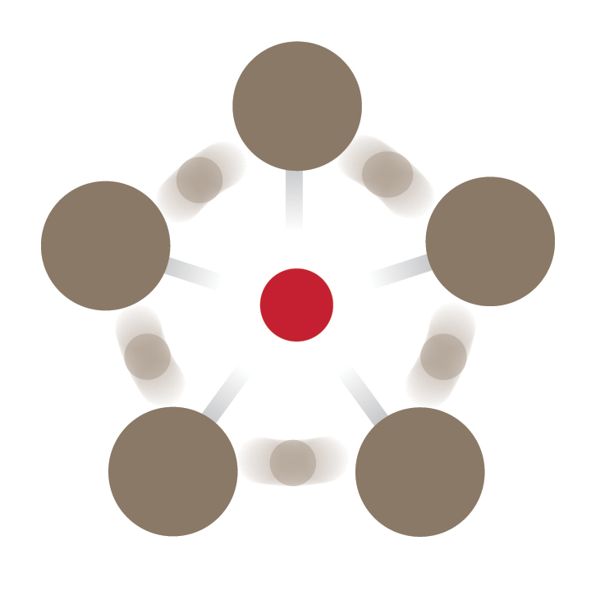

HP Top 5 IT initiatives
Global Data
Centers
Portfolio
Management
IT Transformation
Enterprise
Data
Warehouse
IT
Workforce
Effectiveness
World-Class
IT
Notes:
HP’s top five IT initiatives
Portfolio management
Global data centers
Enterprise data warehouse
IT workforce effectiveness
World class IT
Developed with a no-contingency plan. All must work and all must be done together.
IT transformation must be done quickly. Technology changes fast and CEO tenure is ~ 3 years, so to deliver transformational IT if must emphasize speed to market.

Slide 13

2008
The right direction. The right connections.
% of Revenue cut in half
Less than 30 HP IT core collaboration
sites
WW
~1500
Applications
100% IT managed by IT
80% of resources time
dedicated to innovation
6 NGDCs
In 3 zones
1 EDW
~500 active Business Projects at any given time
Optimized,
Cost effective, & secure network
90%
HP employees – 10% contractors
Notes:
We are on the journey..
Portfolio Management: a reduction from 1,200 projects to 500
Workforce Effectiveness: initiatives have led to tighter collaboration
Data Center Consolidation: on the way to decreased cost, increased processing power and capacity, higher availability and security
Enterprise Data Warehouse: single source providing global access
on track to come online this year
World Class IT Procurement has already
delivered extensive savings

Slide 14
Can we share our experiences with you?
What are your IT professionals working on?
Can you consistently quantify business benefits for all projects?
Can you report % of projects on time?
Do you know the average age of servers and other costly assets?
How many data marts do your servers feed?
How many next generation switches are you running?
Do you know if third party support is cost effective?
We can help. Let’s get started.
Notes:
At HP we have “Turned IT business side up” to become seamlessly aligned with the business.
IT no longer is seen as simply running the business, but rather IT powers the business.
As the world’s largest technology company, HP has a broad portfolio of products and services that can be used to run almost any enterprise on the planet.
What differentiates HP from every other technology company is the depth of knowledge and creativity we can draw upon to solve the biggest IT challenges, an unparalleled synergy between R&D people, product people and service people, all dedicated to delivering technology for better business outcomes to our customers.
The transformation from IT to Business Technology replaces complexity with simplicity, inertia with agility and efficiency, and offers better security, too. Simplicity empowers faster and better decision-making, innovation and new business opportunities. And when a company’s technology is truly aligned on a single goal – better business outcomes – it has achieved a significant competitive advantage in the marketplace.
Thank you.

Slide 15

The CIO IT Consolidation challenge: run your Government IT “like a business”
Government Business challenges
Drive down costs
Improve operational efficiency
Control enterprise-wide costs
Increase Return on IT
Technical challenges
Rationalize and standardize technology
Replace disparate systems and technology
Limit number of platforms and applications
Need to break down functional IT silos to deliver positive business outcomes
Infrastructure
Optimization

Slide 16
IT Consolidation Solution Portfolio
Many isolated, duplicated, hard to manage application environments
Application Consolidation
Data Consolidation
Data Centre Consolidation
IT Management Consolidation
Automated, end-to-end managed IT & application shared services
Over-provisioned, unshared, distributed, inflexible infrastructure
Infrastructure Consolidation
Workplace Consolidation
Virtualized, optimized, scale up/down, reliable infrastructure
Many dedicated, diverse, dispersed boxes (servers, storages,
networks)
Storage Consolidation
Network Consolidation
Server Consolidation
Fewer simplified, standardized and centralized platforms
Notes:
By simplifying, standardizing, virtualizing, and modularizing, IT organizations in enterprises of all sizes can frequently lower their operating costs, improve service levels for the users, increase staff productivity, improve security, and respond much faster to changes in business needs, by consolidating their IT environment. Thus IT Consolidation is often an important step in building a truly Adaptive Enterprise.

Slide 17
IT Consolidation journey
Strategic
IT Consolidation
Align
IT
Consolidation
Optimize
Platform
Consolidation
Simplify
Goals
Cost & business responsiveness
Central operation & distributed control
Rapid IT-enabled time-to- business value
Scope
Focused on innovation
Business & IT lifecycles
Transformation of IT to a service orientation
Attributes
Sustaining IT platforms
Virtualized, automated shared resources
Standardized infrastructure, applications, business processes
“Single pane” operations and management
Dedicated
Silos
Costly, inefficient
Goals
Controlled IT Costs
Improved utilization
Reduced risk
Fast Return (ROI)
Scope
Focused on existing
IT infrastructure
People, process & technology
Attributes
Rationalized boxes, tools, applications
Streamlined operations
Disaster recovery
Partially virtualized
Prone to re-consolidation
Goals
Reduced costs (TCO)
Simplified infrastructure
Scope
Systems & storage
Application platforms
Attributes
Fewer servers
Shared storage
Standardized platforms
Limited virtualization
Prone to re-consolidation
Goals
Fast response
Ease of execution
Scope
Individual project
Attributes
Many isolated, diverse boxes, applications, tools
Hard to manage
Hard to change
Over-provisioned
From tactical to strategic, transformational, consolidation
Notes:
By simplifying, standardizing, virtualizing, and modularizing, IT organizations in enterprises of all sizes can frequently lower their operating costs, improve service levels for the users, increase staff productivity, improve security, and respond much faster to changes in business needs, by consolidating their IT environment. Thus IT Consolidation is often an important step in building a truly Adaptive Enterprise.

Slide 18



IT Consolidation benefits
Improve business and IT operational linkage
Increase number of strategic projects & success rate
Increase IT spending on innovation (20-30%)
Reduce time to value, reduce application deployment (in hours) and reduce project backlog
Enable
competitive advantage
Shared Services
Further increase utilization (40-60%) & improve operations efficiency (up to 1-200+ admin-to-server ratio)
Increase system availability & service levels
Improve responsiveness to business changes
Improve Riot (EVA/IT spending) to best-in-class
Improve
operational
efficiency
Flexible Infrastructure
Improve resource utilization (10-20% to 30-40%) & return on IT asset (reduce CAPEX)
Streamline operations & increase efficiency (reduce OPEX)
Lower TCO (average of 20%) & shift maintenance savings to innovation
Do more
with less
Simplified Platforms
Source: HP, IDC and McKinsey
Notes:
HP IT Consolidation Benefits:
These benefits have been achieved our customers and validated by specific ROI case studies. These references have been confirmed by external studies done by analysts such IDC or consulting firms like McKinsey.
On the cost aspect, doing more with less:
Improve IT Cost Control
Reduce redundancy and Improve resource utilization from 10-20% to 30-40% for a better return on IT asset (reduce CAPEX)
Streamline operations and increase efficiency (reduce OPEX)
Lower TCO (average of 20%)
Reduce maintenance costs and enable shift resources from maintenance to innovation
From an operation efficiency perspective:
Further increase resources utilization (40-60%) with virtualized and shared resources among businesses
Further improve operational efficiency and move up system admin-to-server ratio to 1-200+
Better manage unplanned downtime and further increase system availability and service levels
Improve scale responsiveness to business changes in a cost effective way
Improve Riot (EVA/IT spending) to best in class
From a business point of view:
Improve and demonstrate business value of IT
Reduce Time to Value
Move faster from Test & Dev to Prod
Reduce application deployment (in hours)
Reduce project backlog
Improve business and IT operational linkage and increase agility
Increase # and success rate for strategic project
IT spending on innovation (20-30%)
cBy simplifying, standardizing, virtualizing, and modularizing, IT organizations in enterprises of all sizes can frequently lower their operating costs, improve service levels for the users, increase staff productivity, improve security, and respond much faster to changes in business needs, by consolidating their IT environment. Thus IT Consolidation is often an important step in building a truly Adaptive Enterprise.

Slide 19
Strategic choices for IT transformation
In-house
transformation
Sourcing
continuum
Transformational
outsourcing
Drive your own IT Transformation
Innovate your data centers
HP provides consulting, integration, support, education and program management
Transformation is part of an outsourcing engagement
Innovation elements for transformation through an innovation Council
Driving transformation to Next Generation Data Centers
Who manages assets?
Who owns the service?
Where are the assets housed?
Who owns the assets?
What controls are needed for governance ?
19
12 February 2008
Notes:
What this picture shows is basically HP’s utility computing services portfolio as has been announced by HPS in a joint fashion in early September of 2005.
As you can see it shows the customer the complete offering from “build your own utility” to “plug into HP utility.” It also shows the continuum of some of the parameters that can drive a certain utility solution.
For example, who will manage the assets; is it HP or is it the customer? There could be a discussion around where the assets are housed. Are they housed in an HP data center or are they housed in a customer data center? There could be a discussion about who physically owns the assets and whose books they are on; whether it’s on the customers’ books, on the HP books or some kind of a lease agreement that is in between.
Based on those parameters you can have a continuum of offerings and as you can see on the left side of the slide, shared services is nicely fitting in this model.
Specifically, in those areas where customers want to build their own utilities and become internal service providers and want to manage their own assets, they could. Or they could ask HP to do it and typically would house those utilities in their own data centers and likely they would own or lease the assets from HP.
[Enter any extra notes here; leave the item ID line at the bottom]
Avitage Item ID: {{0538C785-C6C8-48E7-A4B7-F1DC5B9455FF}}

Slide 20
Key transformation domains
IT “Business” Transformation for Government
Application
Transformation
Service
Management
Data Center
Facility & Infrastructure Transformation
Information
Transformation
20
12 February 2008

Slide 21
Transformation methodology; simple, modular, proven
Operate current
Build and transition
Operate new
Current state
Analyze
Define strategy
Objectives and metrics
Build roadmap
Sub-projects
Maturity m +x
ROI
Desired state
Architect -- meet your objectives
Validate results
Maturity m
Plan, Design, Build, Migrate
People-Process-Technology
People-Process-Technology
Manage project, change, quality, architecture, governance and value realization
21
12 February 2008
Notes:
From the previous slide we know that the scenarios will guide transformation to a next step, transformation that needs to cover the people, process and technology aspects.
Reference architectures not only help to design a future state for the technology aspects of this transformation, they also are great for understanding gaps and overlaps (multiple solutions in place for the same architecture component). Finally, Reference Architectures will at the basis for the scenarios, describing how the solution will be build.
Transformation differs from optimization
Optimization is about improving the way things are done or operated today - optimization seeks for small improvements within the current architecture or approach
Transformation is about taking a fresh look on how things are done – doing things differently – transformation is looking at different approaches for multiple things
“New projects” are a simplified form of transformation
Analysis of current environment may be minimal or none
Migration step may not be needed

Slide 22
Maturity models play a key role in the transformation roadmap
Current and desired state based on standard metrics
Domains
Technology &
Architecture
Management Tools & Processes
Culture & Staff
(IT Personnel)
Demand, Supply
& IT Governance
Stage 5:
Adaptive, Shared Infrastructure
Adaptive, Pooled, Automated Infrastructure
Policy-Based, End-To-End, Management
IT Processes Automated & Integrated with Business Processes
Business Process Focused
Real Time Alignment of Supply to Demand
Customer
Desired
State
Stage 4:
Service Oriented
SOA- Compliant Infrastructure Services
Service-Based Management.
Service Centric, Integrated IT Processes
Service Focused
Supply Driven by Service Demand Forecast
Roadmap
based on priorities
Stage 3:
Optimized
Consolidated, Virtualized, Shared Infrastructure
Integrated, Tools & Information
Collection Consolidated, Rationalized, IT Processes
Cross Functional Expert Teams
Centralized Governance
Stage 2:
Standardized
Standardized Tools Standard IT Processes, ITIL
Standardized Technology
Departmental/ Teams
Centralized Policies, Supply Constrained
Current
State
Stage
Stage 1:
Compart-mentalized
Project-Based Management Tools & Information
Ad Hoc IT Processes
Manage to Project Resources & Budget
Dedicated, Project-Based
Technology Focused
22
12 February 2008
Notes:
AIMM is used first to establish the current state of the IT infrastructure, and then to define where the required target state should be for each metric for a given IT organization.
The infrastructure’s current state and desired state is rated against five stages of maturity in each of the domains: Stage 1 – Compartmentalized (least mature); Stage 2 – Standardized; Stage 3 – Optimized; Stage 4 – Service Oriented; Stage 5 – Adaptive, Shared Infrastructure (most mature)
The next step is to identify the priorities in terms of which metrics are most important to make progress on in a given timeframe. This information will then provide a specific roadmap towards an adaptive infrastructure for a given IT organization, and for which specific metrics exist to measure progress towards that goal.

Slide 23
Best practices from our experiences
Timing is crucial – the time is right when IT is considered a strategic part of the business
Transformation is about doing things differently – be open to new approaches
Transformation requires investment – prepare the right business case
Once you get the approval, it is all about execution – deliver the promised value while minimizing downtime
Cross business and project governance are key
Management of change for people, process and technology
Determine the right scope, metrics and strategy early
23
12 February 2008
Notes:
Transformation is about doing things differently – not more of the same
Transformation requires investment – prepare a good business case
Good means: not just IT or cost advantages but a good balance with real advantages to the business. Example: HP-IT included the enterprise data warehouse which about more and better information to more people (not less)
Be prepared to take it to the board: a new data center cost >$100M
Determining right scope and strategy early
Not every customer is willing and/or able to handle the scope and magnitude that HP-IT is taking
Having a scope framework is key to identify the right projects and your capabilities to execute them (with eventual help)
Work with HP, using our framework, to outline a scope that is working for you
You may want to selectively outsource certain activities (e.g. printer or desktop management) to focus more of your resources on the transformation
Once you get the approval, it is all about execution - delivering the promised value while minimizing
It is not often that IT gets this level of executive attention. They can not afford to fail
Be sure to get best practices in executing a project of this size, where it is ROI realization ,project management, architecture assistance, IT process help, tools implementation (e.g. get help from HP)
Timing is crucial and the time is right - IT being more strategic
The best plan at the wrong time, achieves nothing

Slide 24
Key transformation domains
IT “Business” Transformation for Government
Application
Transformation
Service
Management
Data Center
Facility & Infrastructure Transformation
Information
Transformation
24
12 February 2008

Slide 25

IT Business transformation
areas for transformation
IT operating model
  IT as a cost/technology center
  Running IT as a Business
  IT is the business
IT sourcing model
  In-sourced
  Service Brokering
  Outsourced
IT governance
  Enterprise architecture
  Demand and portfolio management
  Financial management
  Understanding and compliance to regulations
Management of change
25
12 February 2008

Slide 26
Making the shift to a business partner
Techno-centric
Service-centric
Business-centric
Business
view of IT
. . . a problem
. . . a solution
. . . a partnership
IT as a
COST center
IT as a BUSINESS
using Shared
SERVICES Model
IT as a
BUSINESS
innovation
enabler
IT organizations are becoming like a “business” within the Enterprise, moving to an effective, value driven supplier/consumer model with the business to deliver shared services
26
12 February 2008
Notes:
Many CIOs are recognizing that they need a new operating model to address the issues they face. They are moving to a Shared Services model, where they have a supplier-consumer model with their lines of business. By acting as a supplier and recognizing the lines of business as their customer – they are giving control back to the lines of business while still reaping the benefits of centralization.
While customers may have a more advanced vision of their desired state, the reality is that most are still mainly a cost center. That means a more step-wise transformation is recommended
The shared services organization introduces new skills and concepts that allow the IT organization to advance in maturity:
By acting like a business, IT starts to better understand the business as it acquires new skills to assess value (price vs. cost), market, sell and plan (service catalog) services
By creating services that are shared between businesses, IT is gaining architecture, persuading and facilitation skills. It need to bring businesses together to drive to common architectures and services. IT learns to become a “change agent”
Through real service based SLA’s (vs. technical SLA’s) IT organizations learn about end-to-end service management and accountability
IT Shared Service organizations and models are also the most cost effective models, allowing transformation of the IT budget spending model from 80% maintenance, to a more balanced 50% maintenance and 50% innovation.
This extra innovation budget, will allow IT to start the journey to becoming a business technology innovation center. Note that IT will not become a business innovator, that remains the role of the business. But, as business innovation relies more and more on technology innovation, IT will have more bandwidth and resources aligned to innovation

Slide 27

Demand and portfolio management
Planning and execution challenges
“Our IT activities are not based on business decisions”
“We have no consolidated view of work, ‘a single instance of truth”
“We are unable to adapt to changing business priorities”
The Operations
Demand
CIO
Lack of visibility and controls
Lack of structural
flexibility
Supply
IT
“We are inefficient with our resources and budgets”
“We have varying levels of project management maturity”
“We are highly reactive in our approach to project and portfolio management”
27
12 February 2008
Notes:
There are several key business challenges that CIOs have to deal with around managing the IT portfolio to meet demands from the business.
Key Business Challenges for CIOs
Reduce operational risk from project failure and not meeting business expectations
Need to deliver IT projects that enable business growth and improve competitiveness with measurable ROI
Need to improve quality and availability of IT and business services and increase end-user customer satisfaction
Need to consolidate and rationalize all IT and business service demand though a centralized mechanism
As a CIO, you know about the business demands. You also have to manage the execution to meet the supply which have a separate set of challenges:
An inability to obtain aggregate, manage and report on all the demand placed on IT,
Need accurate source of the truth across all IT functions, including applications and infrastructure
Lack visibility into IT demand and available resources to properly plan their resource utilization
Usage of multiple disparate tools like inhibits communication and alignment to meet new business goals

Slide 28
Demand/portfolio management solution
Integrated services and software
Services
Software
IT Governance and process design
Business analysis, Project Management and implementation best practices
Project and Portfolio Management Center
Service Management Center
Demand and Portfolio Management Solution
Align operations & IT Increase productivity Reduce project failure risk
$18.8 million in annual savings by canceling non-strategic projects - Large food retailer & Distributor
Project funding process reduced from 6 weeks to 1 week – Large commercial airline
50% improvement in project manager productivity – Packaging & high performance materials
Increased project team productivity by
30% – Birlasoft
Reduced risky projects from 50% to 14% - Autotrader.com
IT project scope changes dropped by 57% - Large food retailer & distributor
28
12 February 2008
Notes:
HP helps customers improve business growth and competitiveness by providing a solution with the right governance, processes and products to improve the management of the IT project portfolio, resources and business services. Using HP Demand and Portfolio Management solutions, customers deliver against IT and business service demands, ensure IT meets business expectations, and reduce the risk of project failure. HP delivers these business outcomes by providing a complete Demand and Portfolio Management solution based on industry standards and best practices that span people, process and technology .
HP services including consulting focused on IT Governance, process design, PPM Software design and implementation, project management and education services
HP Software’s PPM Center includes multiple modules and integration with HP ServiceCenter for an end-to-end solution across the service lifecycle.

Slide 29
Service Management
IT “Business” Transformation for Government
Application
Transformation
Service
Management
Data Center
Facility & Infrastructure Transformation
Information
Transformation
29
12 February 2008

Slide 30
Leveraging ITIL v3
Role of the
IT Function
Service Management
ITIL v3
Strategic
partner
Focus: Business-IT Alignment & Integration
Service Mgmt for Business & Technology
Automated and Integrated Operations
Strategy and Portfolio Governance
Continuous Improvement
IT Service
Management
Service
provider
ITIL v2
Focus: Quality and Efficiency of IT Processes
IT is a service provider
IT is separable from business
IT budgets as expenses to control
Technology
provider
IT Infrastructure
Management
GITIM (ITIL v1)
Focus: Stability and Control of the Infrastructure
IT are technical experts
IT concerned with minimizing business disruption
IT budgets are driven by external benchmarks
Time
30
12 February 2008
Notes:
Over the years, ITIL, the industry best practice for service management, has evolved to support the needs of IT and its ever changing relationship with the business.
Over the last 2 decades, we have seen a radical change in the way the IT organization operates. This change has been mainly driven by the need for the IT organization to deliver concrete value to the business.
In the early 80’s IT was seen as a Technology Provider, the focus was on Stability and Cost Control….It was the era of IT Infrastructure Management… IT were technical experts etc…
Then came IT as a Service Provider and the era of IT Service Management. The focus was on Supply and Demand and in particular the positioning of IT as a service provider…Operation Level Agreements and Service Level Agreements starting flourishing inside the enterprise…and IT was in large still perceived as a cost center, an expense to control…. Although I used the past tense, this is where most of our customers are, with different degree of maturity.
The next step in the maturity spectrum is to move from a Service Provider to a Strategic Partner, that is that IT becomes a fundamental differentiator for business growth. IT extends beyond its role of service provider by becoming an enabler for new business creation (e-commerce) or for better ways of doing business (RFID). Here IT budgets are driven by business strategy….
As mentioned before, ITIL has evolved with the demands of the industry.
ITIL v1 was initially focused on best practice for IT management. How to keep the systems running and best practice in operational procedures.
In contrast, ITIL v2 was still operations focused, but more focused on how services are managed rather than how the IT was maintained. HP embraced ITIL as a best practice for running operations. We developed our reference model to supplement ITIL v2, and continue to help customers implement ITIL v2 processes.
ITIL V3 is focused on how business and IT can improve alignment to achieve business goals. This can be achieved with a complete lifecycle of services beyond IT operations extending into applications and IT strategy. The lifecycle begins with service strategy, then design, transition, operations and continuous improvement.
HP has embraced ITIL as a key foundation for our service management solutions.
We see ITIL v3 as extending the scope of ITIL, embracing both IT and Business service management, linking strategy, applications and operations in a similar way to our solutions.
This should not be a big surprise since HP is a major contributor to ITIL v3, as we were in version 1 and 2. HP has 5 authors to the refresh project including the IT Operations book, the Glossary and process models. This is a prime example of continual support of ITIL which began with ITIL V1 & 2 and HP’s contribution to the service management community.

Slide 31

Running a service-centric IT to match business priorities
Operations/IT Strategy
Service Consumer
Project or Business Process
Business
Business critical processes
Supply
Demand
The Service
Business/Application
Services
IT Services
Application/Infrastructure
Services
Core Infrastructure
Shared Services
(contain the physical
resources)
Enterprise IT
Outsourced IT
31
12 February 2008
Notes:
Main points: In the complexity of today’s IT:
Need business and IT aligned for business goals
Planned demand – business needs to lead with demand
The Service is in the middle – service is a constant
A service-centric approach is critical to leverage all assets across IT architecture, including integrating in-sourcing and outsourcing models. The service will enable IT to provide supply efficiently to help satisfy business demands.

Slide 32
Service Management solutions
Integrated software and services
Demand & Portfolio Management
Infrastructure Management
Change & Configuration Management
Asset & IT Financial Management
The Service
Business Service Management
Consolidated Service Desk
32
12 February 2008
Notes:
HP provides a complete Service Management portfolio with integrated solutions including HP Services and HP Software.
This portfolio embraces ITIL V3 covering “traditional ITSM” in the operations domain and extending into applications and strategy. Solutions:
ITIL V3 – New Service Management
Demand and Portfolio Management - Help customers with the governance, processes and tools associated with Demand and Portfolio Management, thereby supporting the integration of IT and the Business.
Business Service Management - Helping customers implement the process and tools required to get real-time insight into their business process execution and how this relates to the impact IT has on the business ,highlighting IT contribution to the business and help the alignment between business and IT.
ITIL V2 – IT Service Management
Asset & IT Financial Management - Assists customers with the processes and tools required to help gain control of IT assets and financial management, providing the foundation to control and manage the IT budget thus enabling fair cost recovery for service provisioning.
Consolidated Service Desk – Help customers design, implement and continually improve the industry best in class processes for Incident, Problem and Service Level Management, along with the required design, installation, configuration, implementation & training. This solution includes key areas of service fulfillment, and covers service authentication and service provisioning.
Change and Configuration Management - Help customers design, implement and continually improve the industry best in class processes for Change and Configuration management. The solution includes SW transition management and release management, along with the required installation, configuration, implementation and training of the associated automation software.
Infrastructure Management - Design, implement and integrate the Infrastructure and Application management tools required by customers to proactively manage and operate their Infrastructure and Applications within a given service level.

Slide 33
Application Transformation
IT “Business” Transformation for Government
Application
Transformation
Service
Management
Data Center
Facility & Infrastructure Transformation
Information
Transformation
33
33
12 February 2008

Slide 34
Apps became the business of government… but still fail to deliver the outcomes
In the last 30 years, tools & processes have not kept up with the change
More than 50% of IT projects are completed late, over budget or lacking intended features.
Almost 20% are cancelled before completion
The Standish Group
Agility
GAP
Apps are still:
  Monolithic
  Legacy
  Not well integrated
Process
GAP
Processes are still:
  Manual
  Inefficient
  Siloed
Infrastructure
GAP
Infrastructure is still:
  Monolithic
  Under-utilized
  Too complex
34
12 February 2008

Slide 35
Taking a holistic approach
Four major domains of expertise
Packaged Applications (SAP, Oracle)
Application Development & Integration
SOA Transformation
Application Modernization
35
12 February 2008
Notes:
Let’s take a look at how this works.
First, our IT Governance offerings let you capture and process both strategic demand, such as major new projects, as well as day-to-day activities like provisioning, bug fixes, and software updates. Then, projects and workflow requirements are evaluated and prioritized.
During the Delivery phase, and in parallel with the design and development phase, QA and performance teams develop their Quality and Performance plans, including requirements, test planning, and scheduling. The application then moves into an iterative testing cycle, where defects and issues are discovered, isolated, and resolved. During this part of the lifecycle, the integrated automation of Mercury Quality Center and Mercury Performance Center accelerates delivery by leveraging shared assets and capturing important data that is then translated into key performance indicators.
Ultimately, when quality and performance targets are met, a Go/No-Go decision is made based on real-time Quality and Performance metrics (or KPIs) that can be viewed in a roles-based dashboard. A Go decision results in deployment of the application – and the utilization of the Mercury Change Management application.
Once in production, Mercury Business Availability Center proactively manages the availability and performance of the application from an end-user perspective. Any issues or problems that arise are immediately identified (often before the end user is impacted) and diagnosed, enabling rapid resolution.

Slide 36
A pragmatic approach to Application Modernization- achieving business outcomes
TSYS Call Center Application
Modernization
Rapid time-to-market (6 months)
95% reduction in hardware costs
80% reduction in software costs
15% increase in call center productivity
Retire
Re-engineer
Replace
Rehost
Samsung Life Insurance
Rollout 12 Months, US $25M, roughly 1000 person months
Over 2000 DB tables, 53,000 SAM files, 40,000 tapes converted
US $22M cost savings over 4 years
Project cost break even point at 18 months
Retain
Different paths to Application
Modernization
36
12 February 2008
Notes:
Systems do not have to
be hosted on a mainframe
to be considered legacy systems.
Any application that inhibits the implementation of constantly changing requirements can be considered legacy.

Slide 37
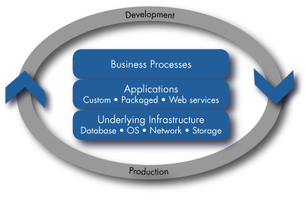
Solutions for application transformation
Helping you with key application Initiatives across the lifecycle
Development
SOA Transformation
Quality
Assurance
Planning
Application Modernization
Application Development & Integration
Staging/ Deployment
Change/
Retire
Packaged Applications (SAP, Oracle)
Application Operations
Application Support
Application
Lifecycle Optimization
IT Operations
37
12 February 2008
Notes:
That is why HP OpenView not only manages applications in production, but we also add management earlier and throughout the application lifecycle – to reduce application costs, and shift resources from maintenance to innovation.
NOTE: We are NOT announcing application lifecycle management. We are announcing that we are adding management earlier, and throughout the application lifecycle. This is a very important detail.
HP is announcing on January 25, 2005 that it is strengthening its HP OpenView Application Management portfolio by adding management capabilities throughout the application lifecycle, effectively bridging the gap between development and IT operations. I
In addition to new and updated products that thoroughly manage applications in production, HP OpenView’s Application Management solutions now help customers build and optimize manageable applications, and automate user and application provisioning to ensure successful deployment and ongoing operations.
HP OpenView Application Management solutions enable tight collaboration between development and IT operations. When combined with the automation of routine and labor-intensive tasks, these solutions enable IT to provide consistently available and well performing applications, reduce overall application costs and shift resources from maintenance to innovation.
HP OpenView’s Application Management solutions are no longer just about infrastructure events in the data center. We have integrated technologies from recent acquisitions around Change and Configuration and Identity management and enhanced products, and introduced new programs to grown our Application Management portfolio and reinforced our commitment to providing solutions that reduce complexity and costs for our customers.
This is not just a vision – it is something we are offering to customers now with unparalleled breadth and depth of coverage.
With HP OpenView, customers can manage the entire application environment, from the underlying network and infrastructure components to the application itself with broad out-of-box coverage of the most popular packaged applications, Microsoft® .NET, COM/COM+ and J2EE application platforms, databases and operating systems.
HP OpenView helps customers maximize their IT investment by reducing the need for complex integrations between multiple vendors’ point tools. Additionally, HP OpenView solution components can also be implemented in a modular fashion, giving customers the flexibility to complement existing functionality.

Slide 38
Information Transformation
IT “Business” Transformation for Government
Application
Transformation
Service
Management
Data Center
Facility & Infrastructure Transformation
Information
Transformation
38
38
12 February 2008

Slide 39
Information management transformation areas
Business Intelligence
Unified Information Management
Data Management
Content Management
Information Management is all about capturing, managing, retaining, delivering, and/or analyzing information across its lifecycle for better business outcomes
Notes:
Information has emerged as a vital organizational asset that must be managed at an enterprise level to deliver the most benefit. The landscape is evolving and we can now define an Information Management discipline: to capture, manage, retain, deliver and/or analyze all information types across their lifecycles to obtain maximum benefit for the business. The IM discipline comprises four domains.
Business Intelligence: Enables visibility, insight, and decision making across the organization for improved business performance and productivity.
Unified Information Management: Enables consistent and comprehensive management strategies and techniques across all information domains. Includes information synthesis and focused, relevant, and actionable information delivery.
Data Management: Managing integration, physical movement, and storage of structured and unstructured data as strategic assets. Maintaining appropriate views of the truth.
Content Management: Improves content workflow, access and control to enhance business processes, decision making and communication.
Business intelligence focuses on the business analytics that inform the business and empower information users to make better decisions, enhance visibility and insight, and drive enhanced performance and productivity. Content management addresses the capture and management of information assets in whatever form they occur and wherever they reside in the organization to improve workflow, access and control.
Data management is the underpinning infrastructure for BI and CM that controls data integration, migration and data movement, and storage of the information assets.
Overlaying all three is Unified Information Management, which represents the common information strategy, quality and governance model, master data management, and synthesis and delivery of information.
These circles overlap because there are significant points of intersection in each of these domains. For example, a business intelligence solution today requires data integration and movement inside the Data Management domain, the common services in UIM, and often crosses the line from pure analytic services into the management of semistructured content in Content Management. We offer services in all these domains but will focus today’s discussion in our core competency around business intelligence. Content management services will be a new offering rolled out in 2008.

Slide 40
Information management challenges drive organizations to act
Current information environment
Business impact
Siloed data marts
Duplicate data and calculations
Limited access to shared data
Excessive effort spent pulling and massaging data
Few reporting standards
No data architecture or governance
Poor data quality
Too many obsolete reports
Lost opportunity – revenue, service, profit
Lost productivity
Multiple “versions of the truth”
Poor data quality
Increased risk to the organization
Solutions
Risk and compliance
Supply chain intelligence
Customer intelligence
CIO analytics
BI consolidation
Enterprise data warehousing
Data marts
BI portfolio management
40
12 February 2008
Notes:
Current customer environments are inefficient and costly and fail to serve the needs of the business. When data is siloed in data marts, plagued by quality issues, and can’t be trusted, the business suffers lost productivity, opportunity, and operational efficiency. For organizations that step up to these challenges, there is tremendous opportunity to achieve competitive advantage by increasing revenue opportunities, reducing cost, and mitigating risk. HP’s transformational information environment offers solutions that address the most common needs of the organization:
Mitigate risk and ensure compliance
Optimize the supply chain process
Attract and retain customers
Monitor and understand IT performance and service to its customers
Gain efficiencies through BI consolidation
Use enterprise data warehousing to deliver the “single version of the truth”
And leverage data marts for departmental views
Finally, manage all the BI assets efficiently
HP BI solutions bring together HP assets in services, software, and hardware to solve our customers’ most pressing challenges.
Risk and Compliance: CentralView for CME, FSI data provisioning, custom (services, partner, software, hardware)
Supply chain intelligence: SAP BIA Appliance, Services, custom (services, partner, software, hardware)
Customer intelligence: SAP BIA Appliance, custom (services, partner, software, hardware)
CIO Analytics: Decision Center, custom (services, partner, software, hardware)
BI Consolidation: Neoview, Infrastructure Consolidation, Ecosystem Consolidation, Data consolidation, Integrity, ProLiant, SAP BIA, custom (services, partner, software, hardware)
Data warehousing: Neoview, Oracle on Integrity, custom (services, partner, software, hardware)
Data marts: Oracle or MS SQL on ProLiant/Blades, Oracle Optimized Warehouse on Blades, custom (services, partner, software, hardware)
BI Management: HP Control Center plus Oracle SPI’s, Unified Infrastructure Management

Slide 41
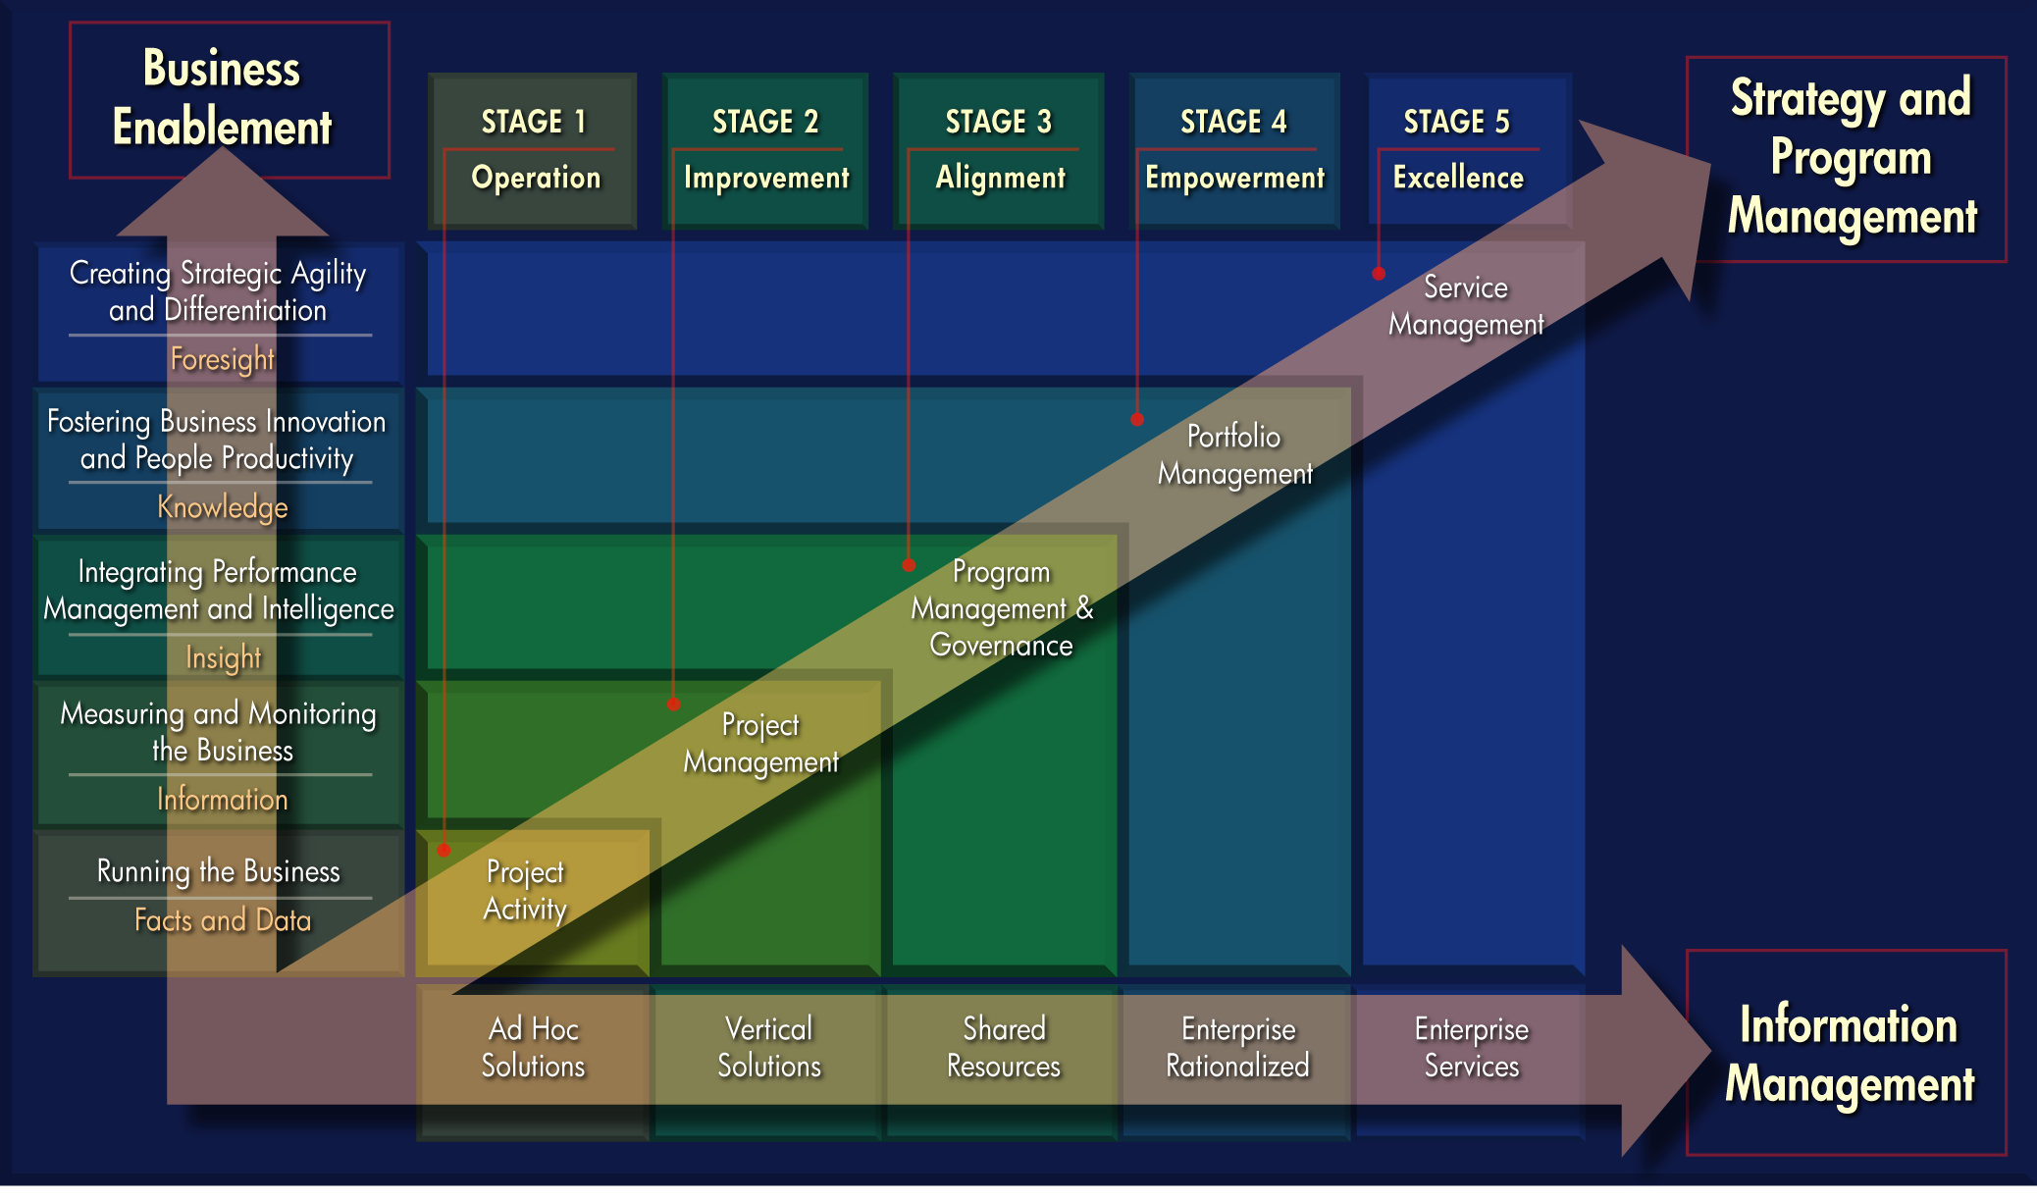
Business Intellegence “BI” as a journey:
The Maturity Model
41
12 February 2008
Notes:
We view BI as a journey that begins with small steps and evolves over time as organizations begin to see the benefits. We have developed the BI Maturity Model as a context for describing the evolution of these capabilities.
Based upon our experiences across industries, we believe that there is a winning formula for long-term success that is a function of three fundamental capabilities: business enablement, information management, and strategy/program/resource management. The model describes the path forward as companies work toward closer alignment across business and IT organizations.
Business Enablement Dimension: This dimension describes the advancing nature of the types of business needs/problems that are solved with information/intelligence solutions. Early business needs focus on the enhancement of basic reporting and analysis capabilities, and they often support the automation of existing capabilities. Once the basic, localized reporting needs are satisfied, then the business drivers turn to a higher degree of alignment and integration, usually described by a linkage with a broader business performance management agenda within the organization. At this point, we see a heightened focus on the value of analytics, often embedded within other systems or business workflows. The latter stages of business enablement are characterized by the leverage of intelligence to transform the way business processes are designed and the way people work. Finally, the most advanced business needs are those that provide business capabilities that differentiate the organization strategically. At this level, the organization benefits from an agile information environment, where information no longer prohibits strategic agility but promotes and enables it. Key to this dimension are skilled Business Solution Architects, who possess a breadth of understanding across all three dimensions and a clear depth in performance management and analytics.
Information Management Dimension: This dimension describes the advancing nature of information solutions that serve a variety of business needs. Early information management solutions focus on gaining basic access to data. These are often local, ad hoc efforts focused on meeting local demand. Next, we see a shift to serving needs of specific subject areas of information. Vertical data warehouses and data marts are commonplace. The third stage is critical to alignment across a business unit or enterprise. Integration across subject areas and across business unit solutions are key. Next, the enterprise reconciles to create a single version of truth across the organization. At this stage, we see elements of unstructured content being integrated with the basis of structured content. Delivery of information reaches new heights with closer integration using portals. Finally, the most advanced information management capabilities are those that provide information via a service model. Key to this dimension are skilled Information Solution Architects, who possess a breadth of understanding across all three dimensions, as well as a clear depth in information strategies and architectures and robust technical infrastructure.
Strategy and Program Management Dimension: This dimension describes the advancing nature of management skill as a key enabler and catalyst for success. Early stages are described by localized, project activity. This is followed by a recognition of the criticality of project management as a discipline as a means to manage scope, mitigate risk, and manage costs. As business needs advance and information solutions reach higher levels of integration, management skills become critical to success. Stakeholder management (i.e. governance), resource management (i.e. outsourcing), and change management (i.e. competency centers) become key skills to facilitate heightened levels of integration. At the next level, portfolio management becomes of higher importance as business intelligence becomes a natural component to all strategic initiatives. Finally, as information becomes more readily available, a service-based model for management is required to effectively and efficiently manage. Key to this dimension are skilled Program Managers, who possess a breadth of understanding across all three dimensions, as well as a clear depth in managing large-scale strategic programs, portfolio management, change management, and resource management.

Slide 42
Data Center Facility & Infrastructure Transformation
IT “Business“ Transformation for Government
Application
Transformation
Service
Management
Data Center
Facility & Infrastructure Transformation
Information
Transformation
42
42
12 February 2008

Slide 43
Data Center Transformation framework for better business outcomes
From HP.
Data Center Transformation
Data Center Strategy
Data Center
Design
Data Center Deployment & Transition
Data Center Operation
Data Center Continual Improvement
Decrease Cost
Mitigate Risk
Accelerate Business Growth
Business outcomes
Service lifecycle
IT Outcomes
Energy and Space Efficient
Always On
Global and Virtual
Service Oriented and Automated
IT Systems
& Services
Power &
Cooling
Management
Security
Virtualization
Automation
Adaptive Infrastructure enabling the next generation Data Centers
43
12 February 2008
Notes:
This is the most complex slide in the deck, so we will guide you through it.
It is our whole DCT framework in one picture !
Right side, top, you will find the 3 major business outcomes for optimizing the data center. Business outcomes reflect how optimizing and transforming IT will benefit the business. We identified 3 key business benefits:
Decrease cost
Mitigate risk
Accelerate business growth
Right side, center, you find our attributes for an optimized data center. HP’s POV is that an optimized DC has 4 characteristics
Energy and space efficient
Always-on
Global and Virtual
Service Oriented and Automated
Right side, bottom, you will find the AI enablers, that helps us to implement the optimized DC.
Left, you will find the HPS service lifecycle for DCT. The service lifecycle represents our methodology and how we help customer transform and optimize the data center in a structured, phased approach. This is the methodology that allows us to execute deals that are $100M in size for HPS. The methodology is equal to the service lifecycle in ITIL v3, which is not a coincidence and highlights HP’s leadership and involved in the ITIL and Service Management area.
An optimized data center that meets your needs today
and into the future has four key characteristics:
Energy and space efficient. It ensures power and
space requirements are met—now and in the
future—and minimized by design.
Global and virtual. It consists of a consolidated and
virtualized infrastructure with modular designs that
make technology upgrades fast and easy.
• Highly Available It meets critical availability
requirements by incorporating rock-solid resiliency
into the overall data center design, operations and IT services.
Service oriented and automated. It delivers IT
as a service while automating data center
operations for faster time-to-market
This optimized data center provides tangible customer Benefits
Decrease cost: Real estate, systems upgrade, power and cooling and operational costs make up big part of data center costs. Data Center is very critical to the business but owning and operating data center is a big task- not core to the business
Mitigate risk: with customers and data centers being more global, the DC needs to support the business 24x7, be secure and quickly recover after a disaster. After consolidation, criticality and need for proactive risk mitigation increases.
Accelerate business growth: every new business project involves an IT project that may add capacity to the data center. The data center should provide the scalability, availability, the space and power effectiveness to flexibly support business growth
Customer Themes – Our attributes of and ideal data center, also where our customers are struggling with- HP’s vision (Point-of-view) for the optimal data center
Energy Efficient data centers: Being energy and site efficient adds to your bottom-line. Environmental guidelines will become more important and more compliance requirements are on the way in the face of global warming
Always-on data centers: with customers and DC’s being more global, downtime is no longer acceptable. The new best practice is to build business critical support and availability (BC&A) into the DC, rather then build the BC&A solution for each application individually. Proactive support and best proactive service management becomes important after consolidation and virtualization.
Consolidated and Virtualized data centers: HP leads the way with the DCC project, but many customers are looking at consolidating data centers and using virtualization solutions to create more dense and better utilized data center infrastructure
Global and Virtual: HP believes data centers will be operated in service-oriented (ITIL), lights-out fashion. Companies will increasingly source services for DC service providers and outsourcers. A Datacenter is nothing more or less then a service Infrastructure, meaning it provides a service to other services.
Data Center Lifecycle- how are we delivering this vision in integrated fashion?
HP helps our clients with the strategy, design, deployment and
Adaptive Infrastructure Enablers
These 6 areas are where HP invests in key technology trends for data centers

Slide 44
IT’s energy woes: some scary numbers
The total power demand by servers WW in 2005 was equivalent to about fourteen 1000 MW power plants. (Jonathan G. Koomey, Ph.D. Staff Scientist, Lawrence Berkeley National Laboratory and Consulting Professor, Stanford University, February 15, 2007)
Servers in the United States and their attendant cooling systems consumed 45 billion kilowatt-hours of energy in 2005. That's more than Mississippi and 19 other states (“U.S. servers slurp more power than Mississippi”, Cnet News, February 14, 2007)
A typical 10,000-square-foot data center consumes enough juice to turn on more than 8,000 60-watt light bulbs . . . companies that own them could end up paying millions of dollars this year just to keep their computers turned on. And it's getting more expensive. (CIO Magazine, April 15, 2006)
“Beam me u …….ah……… Scotty …………….…..… Scotty?”
44
12 February 2008
Notes:
Google is said to spend almost $100M annually on electricity (IDC)
Power and Cooling is such a “hot” topic – why the increasing customer focus?
Moore’s law is confronting the Laws Physics
Customers are finding it increasingly challenging to take advantage of improvements in processor performance and system density
Facilities and data center design has not kept pace with the advancement in technologies
Increasingly Facilities and IT are finding they need to be working much more closely as a team
Rising energy costs
energy consumption is becoming a larger proportion of IT spend [KEO1]
Data center electricity costs are already in the range of $3.3 billion annually (source: IDC)
Data center utility bill exceeds the cost of acquiring new computers for some companies
It can cost more to cool a data center than it does to lease the floor space to house it.
Estimates suggest that the average annual utility cost for a 100,000-square-foot data center has reached $5.9 million (Source: Edward Koplin, a principal at engineering firm Jack Dale Associates).

Slide 45


An industry-changing event:
EYP Mission Critical Facilities
Best-in-class Mission Critical Facilities consulting firm
Hitting the spectrum
Infrastructure integration
Data center planning, design, optimization and management
Integrating
state-of-the-art mission critical facilities
End-to-end
capabilities
Concept to operations
Global reach
Spanning clients in all regions of the world
Capitalizing on leading-edge intellectual property
45
45
12 February 2008
12 February 2008

Slide 46

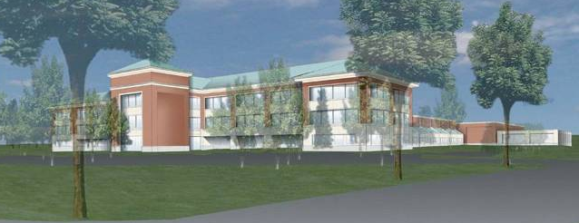
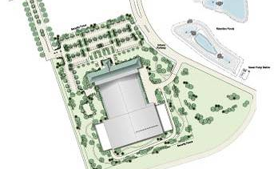
Performance Evaluation – Energy Efficiency
The ‘Onion Approach’ from
Core to Source
Electric performance
Server performance
IT
Performance
Primary energy performance
HVAC performance
EYP MCF project: First LEEDTM Data Center
120,000 sf data center for Fannie Mae in a 250,000 sf new building
This facility consisted of 60,000 sf raised floor computer room, 30,000 sf of infrastructure space, 25,000 sf of equipment yard and a 120,000 sf, three-story plus basement office building
46
12 February 2008
Notes:
LEED is an acronym for Leadership in Energy and Environmental design. The rating system provides a framework to help move the U.S. building industry to more sustainable practices. The LEED rating system is based on points that are achieved by meeting specified energy efficiency requirements. Many clients now require experience in LEED certified projects and often will mandate that LEED Accredited Professionals are a part of the design team.
EYP MCF is a leader in LEED and energy-efficient design including development of EnerOpt™, a robust energy assessment and optimization software tool for data centers. EYP MCF is also currently designing several LEED-rated facilities, including a new, $100MM+ Greenfield data center which is targeted to be LEED sliver.
Fannie Mae’s Urbana Technology Center was awarded LEED certification, thus becoming the nation’s first LEED-certified data center. Some examples of the energy efficient and environmentally friendly and applications designed into the UTC include building automation/building monitoring systems that monitor trend, control, and adjust the facility’s heating, cooling, ventilation and humidification systems, use of non-ozone depleting refrigerants and a selective catalytic reduction system.

Slide 47
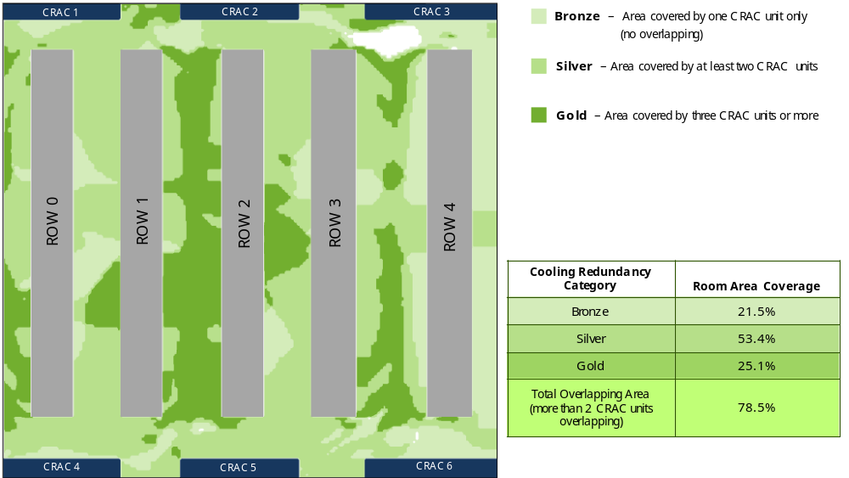
HP Thermal Zone Mapping
Quantification of overlapping regions
Areas that are served by 3 or more CRAC units are be classified as “gold”— target that space for placement of business critical machines
Areas without redundancy are the highest risk areas
47
47
12 February 2008
12 February 2008

Slide 48
HP Services Customer Data Centers
Driving global platform and process standardization
Current state – 70 centers, 850K sqft.
Future state – 52 centers
  7 NGDC; high density power & cooling
  16 global/regional
  29 dedicated customer centers
  1.1M+ sqft. projected
Remote monitoring
  90% off shored
  Costa Rica, KL, Bangalore, China…
Platform & Process Standardization
  Adaptive Infrastructure Services
  Application migration & on boarding
Norway (2)
Finland
Sweden (2)
Toronto (2)
United Kingdom (5)
Netherlands (3)
Belgium (3)
Germany (7)
Denver
Columbus
Littleton
France (2)
Switzerland (3)
Colorado Springs
Cincinnati
Spain
Italy
Seoul
Alpharetta
Sterling
Houston
Suwanee
Monterrey
Tampa
Kuala Lumpur (2)
Singapore (2)
São Paulo
Perth
Sydney(2)
Melbourne
Christchurch
Next-Generation Data Centers
Global/Regional/Customer Dedicated
48
12 February 2008

Slide 49
Adaptive Infrastructure as a Service
Pre-defined environment
Optimized for
1
Adaptive Infrastructure as a Service
2
  High-density datacenter optimized for demanding
  power & cooling
  Owned & secured by HP, managed using
  ITIL/ITSM tools & processes
  Flexible dial up and down access to latest technology
  Expert resources & methods to deliver fast application modernization
SAP
MS Exchange
Infrastructure:
  Linux
  Windows
  HP-UX
3
based on
Adaptive Infrastructure innovations
IT Systems
and Services
Power and
Cooling
Management
Security
Virtualization
Automation
49
12 February 2008
Notes:
The HP AIS service will be delivered from the Atlanta, Georgia NGDC in North America. There is an NGDC scheduled for Isle d’Abeau in May, 2008. The delivery of the service is not limited to the region in which the client is based. Larger enterprises with global presence will be less sensitive to the HP delivery location.

Slide 50
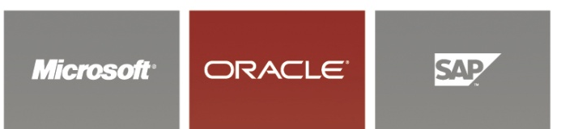
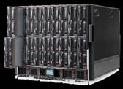
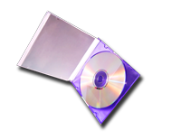
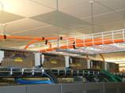
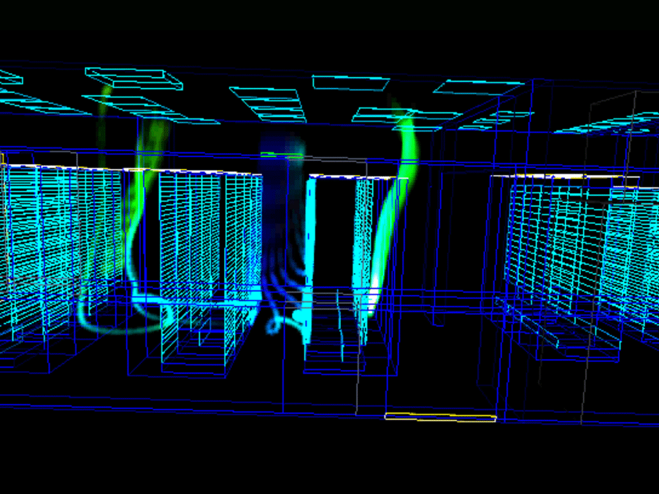
Standardization overview
Platform standardization – Standards driven environment
Technology and Standards
Facility
Enterprise
Application(s)
Operating Systems
MS Server
Linux
Unix
Architected
Interfaces
Compute Standards
Shared Services
Web Server
Middleware
.Net – J2ee - LAMP
Platform
(HW & OS)
Cooling
Network
Network Standards
Power
50
Thermodynamics Modeling
12 February 2008
Notes:
50

Slide 51
What we talked about today
IT “Business” Transformation for Government
Application
Transformation
Service
Management
Data Center
Facility & Infrastructure Transformation
Information
Transformation
51
12 February 2008

Slide 52
Considering Elements for Transformation
Service Management
Infrastructure
Applications
Information Management
Outsourcing
Consolidation & Migration
Data Center Transformation
Network Solutions
Bus Continuity & Availability
Mission Critical
Deployment & Support
Apps Modernization & SOA
Packaged Application (SAP, Oracle)
Apps Development Integration & Management
Business Intelligence/EDW
Documents & Records Mgmt
Info Archival & eDiscovery
IT Service Management
Business Service Management
Project & Portfolio Mgmt
Infrastructure
Applications
EUWS
Managed Print
BPO F&A
AI-as-a-Service
Notes:
Our portfolio is structured into 5 areas:
Infrastructure
Service Management
Applications
Information Management
Outsourcing
Infrastructure
Is core to HP Services. We have done over 1,000 IT consolidations and migrations
This set of services is focused on helping you manage your data center environments better
Service Management -- I think of this area as the ERP for IT. The integrated power of Openview, Peregrine, Mercury and Opsware position us second to none in this space. We have several thousand consultants that line up against this suite of Software.
In the Applications area – our priority are to continue to scale our SAP and Oracle practice. You might have seen the announcement we made earlier this week where we acquired a EMEA-based applications firm that adds another 450 apps experts.
With the acquisition of Knightsbridge earlier this year, we have established a leadership position in Information Management.
With the continued explosion of data – this is a big area of growth for us.
As Randy mentioned in yesterday – a big part of any successful transformation includes BI and EDW.
Outsoucing – we have over 700 clients – and are making significant capital investments:
We are bringing on line – 7 Next Generation Data Centers over the next 24 months
3 are based in the US – where we flank Randy – and 4 will be located outside the US
In the facility we are touring this afternoon – HP Services has a handful of clients
Let’s switch gears and talk about Data Center Transformation

Slide 53



Progression by understanding your government business needs
Examine operations/IT strengths, weaknesses, priorities and role in success
Profile
Prioritize
Identify critical areas of impact and investment based on priorities
Recommend operations/IT approaches and investments that address the critical priorities
Prescribe
Notes:
HP partners with enterprise customers to determine the best solution together
First we profile – examine business and IT needs, strengths, weaknesses and goals.
Then we prioritize – figure out the most important steps based on your needs and resources.
Finally we prescribe – recommend a tailored solution that delivers the optimal answer for your business or IT problem.
Avitage Item ID: {{8E90BF0D-A7D5-4AAD-AB33-8E37D4FC2918}}

Slide 54
The end result of IT Transformation for Government
Gov’t Operations and IT synchronized to improve on change
Government Operations
Information Technology
Benefits: simplicity, agility, value
Notes:
At HP, we and our partners work with your team to become an Adaptive Enterprise. As both a strategic partner and an advisor, we bring experience, a portfolio of standardized, modular technologies and services, and clear architectural guidelines that help you move forward in evolutionary phases. Throughout the process, we share information, insights, and best practices.
Working with HP to become an Adaptive Enterprise enables you to address core business needs— maximize returns, mitigate risk, improve business performance, and increase agility—while continuing to meet today’s business challenges. By creating an environment in which business and IT are synchronized, we help you to create an enterprise that can take change in stride, seize new opportunities, and capitalize upon rapidly changing market conditions—all of which puts you in a powerful position to deliver value, compete, and win in a rapidly changing world.
At the heart of an Adaptive Enterprise is the understanding that business and IT must be synchronized —that is, they must become aligned and stay aligned—for the enterprise to capitalize on change. A business decision— for a new product or service, for a rapid introduction of new products, adoption of a new product or service or any other decision—triggers a series of IT changes. Consider:
A brokerage house needs to be able to update and change its systems to comply with updates and changes in government regulations. For IT, this creates the need to:
Update systems quickly to address short-term reporting requirements
Undertake a longer-term effort in parallel to define a comprehensive, flexible architecture for auditing information systems and operations
An entertainment company must distribute movies across new devices and networks. For IT, this need translates to projects like:
Develop a new media lab
Develop a rights management system for protecting copyrighted property
Develop better online collaboration mechanisms with technology and distribution channel partners
Develop new online support for end-user self-help
A retailer requires real-time supply chain insights to solve emerging inventory problems. IT requirements that must be addressed quickly include:
Identify critical supply-chain key performance indicators (KPIs)
Develop and deploy Web-services–based transactions and workflows to propagate the KPI data across the parties in the supply chain
Implement RFID to strengthen asset tracking, inventory management, and forecasting
Today, every strategic business decision triggers a chain of IT events. The challenge is to ensure that those IT events occur as quickly as the business decision makers need them to occur—and that is where most organizations fall short. The IT organization must translate the new priorities into updated systems and processes, sometimes across multiple layers and organizations. Too often, the IT infrastructure is inflexible, this entails complex, costly, and lengthy change initiatives.
The ideal is to restructure the systems to allow rapid reconfiguration in response to unforeseen needs. Accomplishing that requires strong IT governance and a comprehensive, well-integrated enterprise architecture.

Slide 55
Translation to Government’s Mission
Safer Communities
Protect our citizens and infrastructure
Sustain Government Operations
Provide a secure, agile & innovative infrastructure to meet/exceed the traditional
and evolving missions of the government agencies
Better Services to Citizens:
Make government more citizen centric

Slide 56
Closing Slide

